Slide 1

Collective consumer protection in the Law of different eu Member States
GEULEN & KLINGER
Rechtsanwälte
RA‘in Karoline Borwieck – Geulen & Klinger Rechtsanwälte

Slide 2
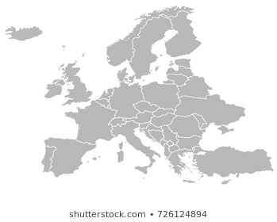
CONSUMER PROTECTION RIGHTS IN EUROPE –
WHAT TO DO IN CASE OF INCORRECT FUEL DATA?
  Belgium
  Germany
  France
  Italy
  Netherlands
  Austria

Slide 3
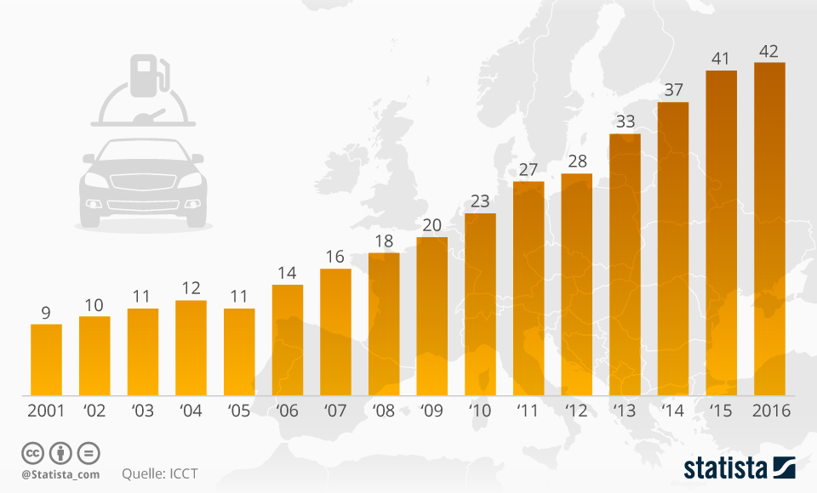

Why do we need An overview?
Deviation of the fuel consumption of new passenger cars in comparison with the manufacturer's data in %

Slide 4
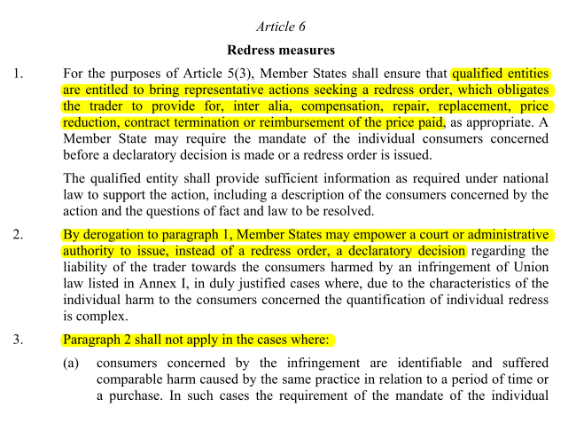
Why do we need An overview?
„New Deal for Consumers“
  Proposal for a DIRECTIVE OF THE EUROPEAN PARLIAMENT AND OF THE COUNCIL on representative actions for the protection of the collective interests of consumers, and repealing Directive 2009/22/EC of 11 April 2018
    26 March: 1st Reading

Slide 5
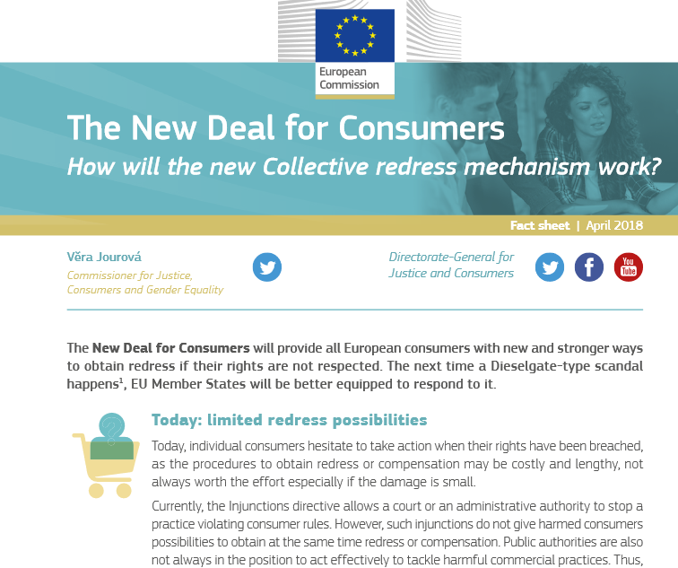
Why do we need An overview?

Slide 6
How was the overview prepared?
BASIC QUESTIONS | OPTIONS FOR ACTION
What forms of class action are planned in your country? | What concrete measures does a consumer have to take to join or initiate an ongoing class action?
Since when? | What is the consumer's claim against the car seller?
What are the main characteristics of these forms of collective redress? | What are consumers' claims against the manufacturer?
What conditions must be met?

Slide 7

Part I – Basic questions
RA‘in Karoline Borwieck

Slide 8
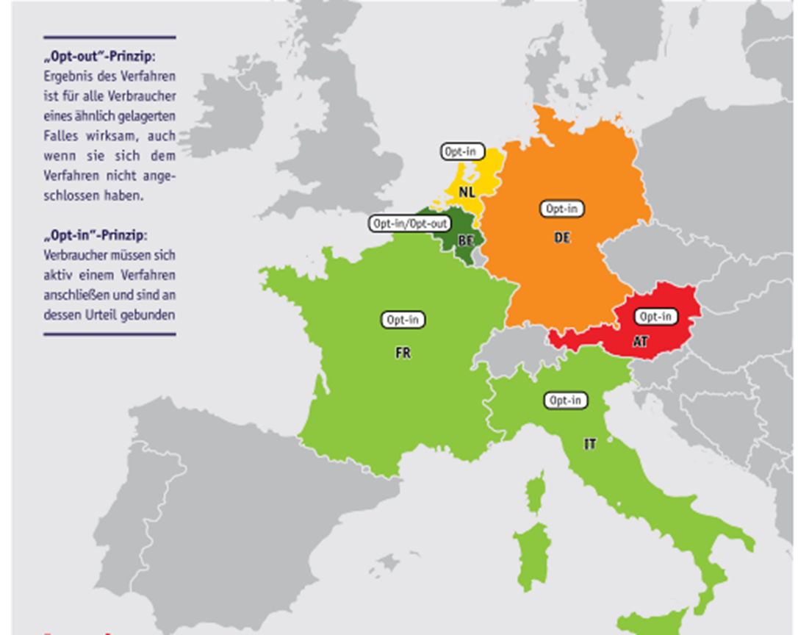
Overview: Collective Consumer Actions

Slide 9



Overview: Collective Comsumer Actions

Slide 10
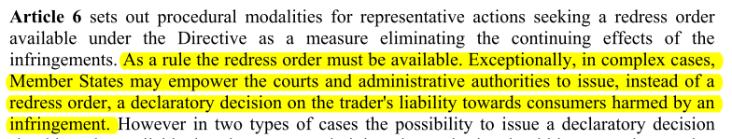
Declaratory actions in germany „Lex Diesel“ –
Musterfeststellungsklage
Declaratory actions
Only qualified entities
  Members: at least ten associations active in the same field of activity or 350 natural persons
  Have to qualified for at least 4 years
  Have to protect consumer interests through non-commercial educational or advisory activities
  Declaratoy actions only for non-profit reasons
  Are not allowed to get more than 5 % of their financial resources from companies
At least 50 consumers must join

Slide 11
What needs to be better?
Right to sue for all environmental and consumer associations
Action with focus on elimination of consequences, not only determination
Legal standing also for consumer groups
Limiting court costs to contain financial risk
Contact point for incorrect fuel consumption data
Correction of the official consumption values if deviation was detected
Sanctioning fraudulent practices

Slide 12
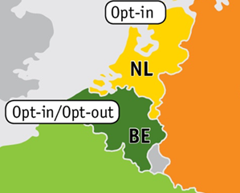
CLASS actions FOR COMPENSATION in BELGIUM
Belgium offers „real“ class actions for compensation
Court decides for every case if an „opt-out“ or „opt-in“ system will provide better protection for the consumers
Low cost risk for consumers
Belgium meets the standard of the „New Deal for consumers“

Slide 13

Part II – What can Consumers do?
RA‘in Karoline Borwieck

Slide 14
what can consumers do?
INFORMATION
  Consumer centres, associations, lawyers
ACTION
  Initiate or join a class action
  Observe deadlines

Slide 15
Claims against car sellers
WARRANTY CLAIMS DUE TO DEFECTIVENESS
  Limitation period for new cars 2 years; used cars partly shorter
CLAIMS FOR UNFAIR AND MISLEADING COMMERCIAL PRACTICES
CLAIMS ARISING FROM CONTESTATION

Slide 16
Claims against car Manufacturer
GERMANY & AUSTRIA
  Conclusion of contract usually with car seller; no warranty rights vis-à-vis manufacturer
BELGIUM
  Liability for incorrect product information
FRANCE
  Warranty rights based on "hidden defects
NETHERLANDS
  as against seller (misinformation, unfair business practices, etc.)
ITALY
  possibly unfair commercial practices

Slide 17
WHEN can we speak about deficiency?
Court decisions so far only in Germany
DEFICIENCY : more than 4 percent
(OLG Düsseldorf, judgment of 18 August 2008 - 1 U 238/07)
  2 percent fault tolerance for technical products
  2 percent deviation due to measurement inaccuracies
SIGNIFICANCE of the deficiency: more than 10 percent
(BGH, Resolution of 8 May 2007 - VIII ZR 19/05, DAR 2007, p. 516)

Slide 18

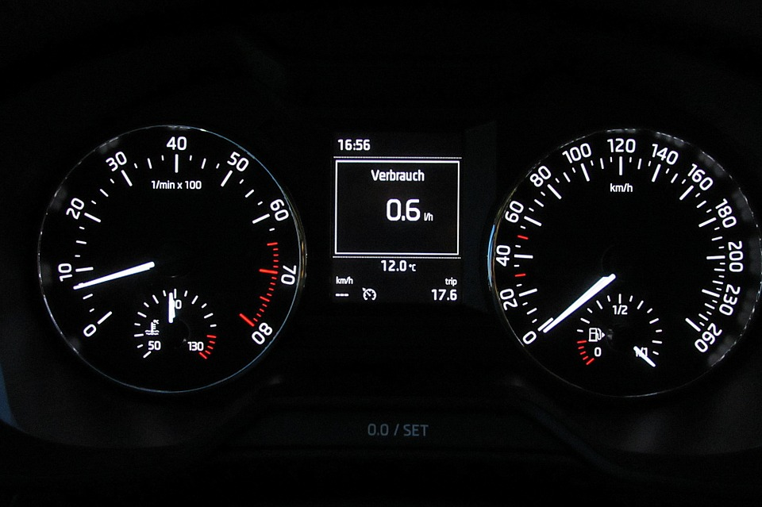
burden of proof
Does a consumer meet the requirements to join the class action?
Does the additional fuel consumption constitute a defect?

Slide 19
Costs
Low cost risk for consumers
  Problem: full cost risk where only declaratory judgment can be obtained collectively because of following trials

Slide 20
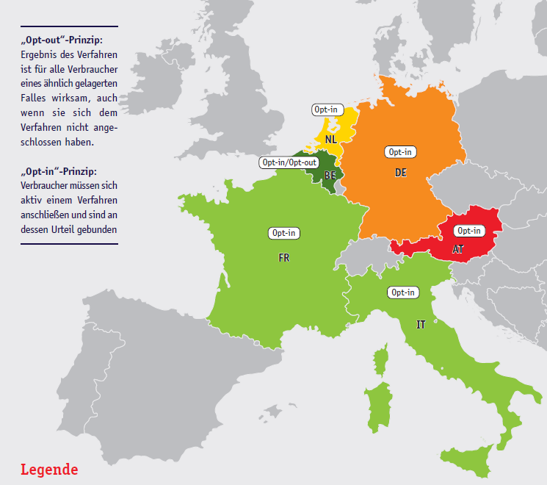
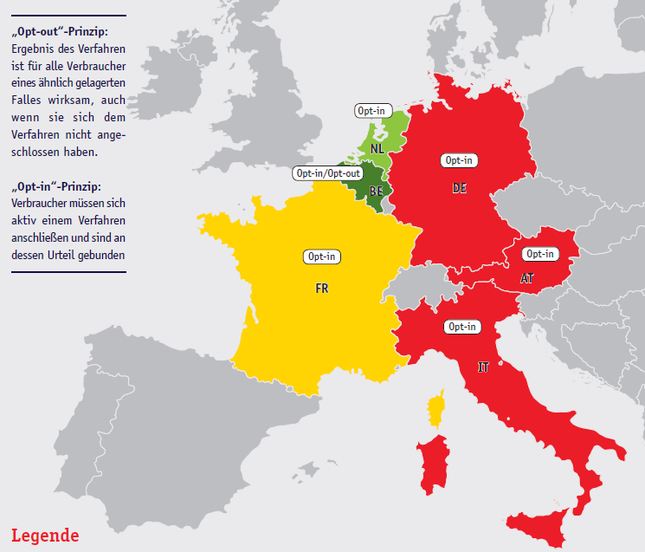
Collective redress in Theory and practice

Slide 21
Rechtsanwältin Karoline Borwieck
Geulen & Klinger Rechtsanwälte
Schaperstraße 15
10719 Berlin
www.geulenklinger.com
borwieck@geulen.com
Tel.: 030-884 72 80
Fax: 030-884 72 810

